Slide 1

Dimensional Alchemy
Turning Data Model Lead to Gold
Jorge Segarra | Microsoft | @sqlchicken

Slide 2
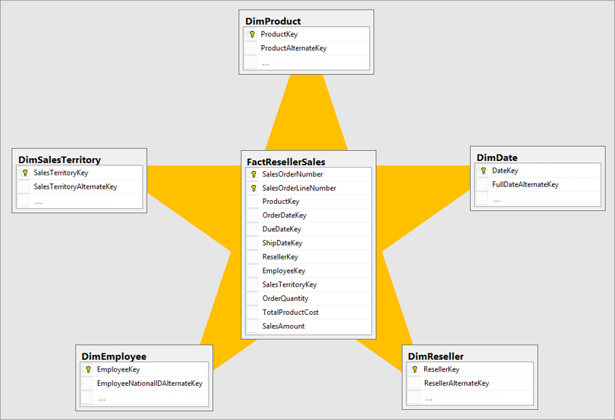
Why Dimensional Modeling?
Star schemas optimal for reporting queries
Tabular model optimized for star schemas
“Well-designed model is one that provides tables for filtering and grouping, and tables for summarizing” (source)
Reduced complexity
Better scale and performance
Star Schema Guidance

Slide 3
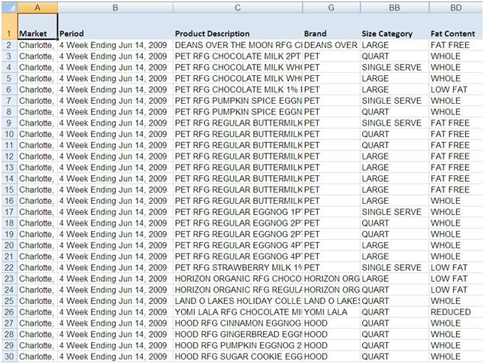
Typical Data
One flat table
Pro: Simple
Con: Increased data redundancy/inconsistency
Con: Scales poorly

Slide 4
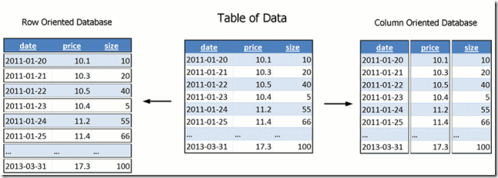
Tabular Model
Tabular is columnar
Less cardinality = better compression
Tabular compression ~ 1/10 or better
Data reduction techniques guidance

Slide 5


More questions?
.
Global Power BI User Group
Go to Power BI Guidance
Go to free Guided Learning
Notes:
In Slide Show mode, select the arrows to visit links.

Slide 6
Thank you!

